Slide 1
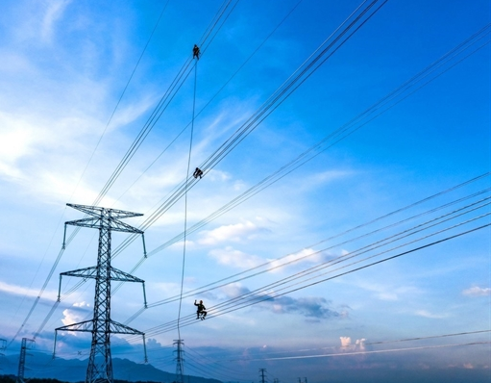



Samsung SEVT × TTC Duc Hue 2
Vietnam's First Grid-Connected DPPA — Directional Economics

Slide 2


Off-Site Solutions:
Models Emerging in Vietnam
C&I Electricity Users’
Off-Site Clean Energy
Options in Vietnam
Physical
Direct Power Purchase Agreements
Synthetic
Direct Power Purchase Agreements
First grid-connected DPPA now live (Samsung–TTC, Jun 2026); broader rollout still early
First tangible project example now operating, reducing cost-saving uncertainty
Customers have to factor in transmission and distribution costs and risks

Slide 3

What is a DPPA?
A Direct Power Purchase Agreement (DPPA) is a contractual agreement between an RE generator and a customer that enables the customer to procure clean electricity from off-site sources, including utility-scale solar and wind installations.

Slide 4
Off-Site DPPA:
Physical Model
= Electricity
= EACs/RECs
= Financing
Your Company
Physical DPPA
Enables direct electricity trading between a renewable generator and an energy customer
Private Wire Connection
Energy customer and renewable generator sign a power purchase agreement
Energy customers bear the costs of developing a private wire connection
Renewable generator transfers electricity and environmental attributes to the customer
RE Generator

Slide 5
Off-Site DPPA:
Synthetic Model
= Electricity
= EACs/RECs
= Financing
Your Company
Synthetic DPPA
Enables electricity trading between a renewable generator and an energy customer through national power grid
EVN
Energy customer finalizes a PPA with a project developer for a strike price per kWh.
EVN provides corporate buyer with all electricity needs at the retail tariff
On a monthly basis, the energy customer settles the financial payment with the RE developer equal to the difference between the spot market price (FMP) and the strike price
RE Generator

Slide 6

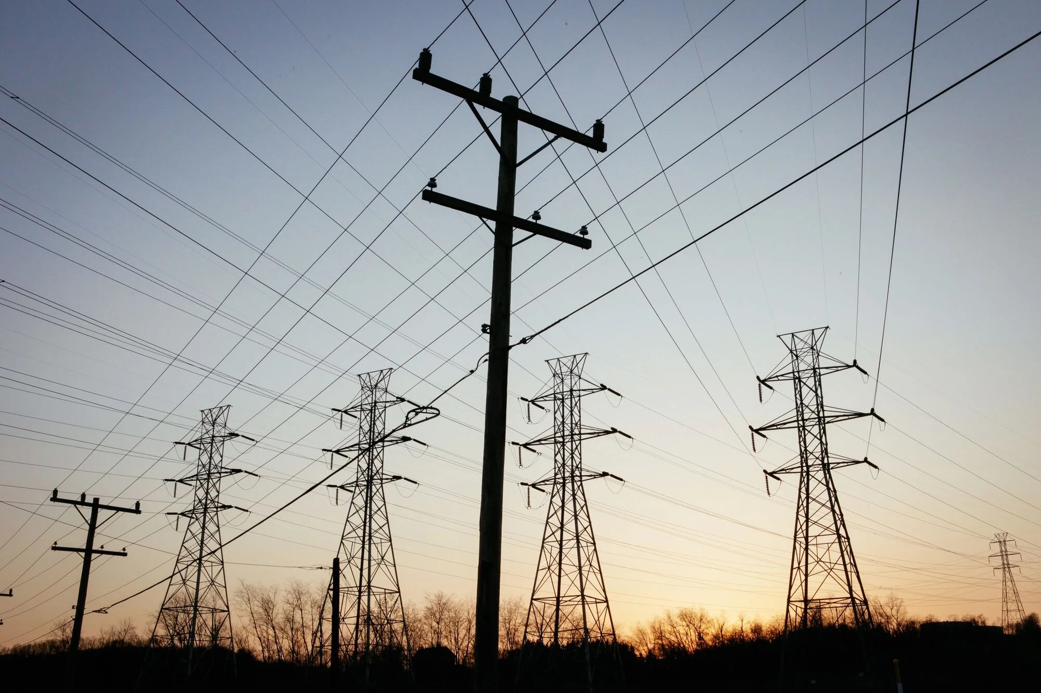
Synthetic DPPA:
At-a-Glance
Advantages
Enables up to 100% of demand to be met by RE
Larger off-site projects can drive down costs
Long term price stability and predictability
Available to customers with owned/leased facilities
Disadvantages
Only available to large energy consumers with an average monthly consumption of ≥200,000 kWh
In early stages of adoption. No project examples exist to date
Data for cost calculation still being confirmed
Buyers bear transmission costs and risks
Notes:
ADVANTAGES:
DISADVANTAGES:

Slide 7
Off-Site DPPA:
Risks and Mitigation Strategies
Potential Risks
Mitigation Strategies
Implementation
A first grid-connected example is now live (Samsung–TTC, Jun 2026); the market is still thin, so early buyers remain first movers
Engage experienced technical and market experts to provide local transaction support
Pricing
Fluctuations in energy prices can impact financial viability of a given project
Implement fixed pricing or floor/ceiling to mitigate exposure to market volatility
Policy
Regulatory and policy changes can impact the financial and operational viability
Performance
Consider flexible contractual provisions that mitigate financial impacts of regulatory changes
Performance
Underperforming projects may fail to meet expected operational standards
Consider performance guarantees and annual O&M reports to ensure the project meets specified operational metrics
Financing
Financing
Risk that developers could default or encounter financial difficulties
Conduct due diligence on financial health of developers and service providers

Slide 8
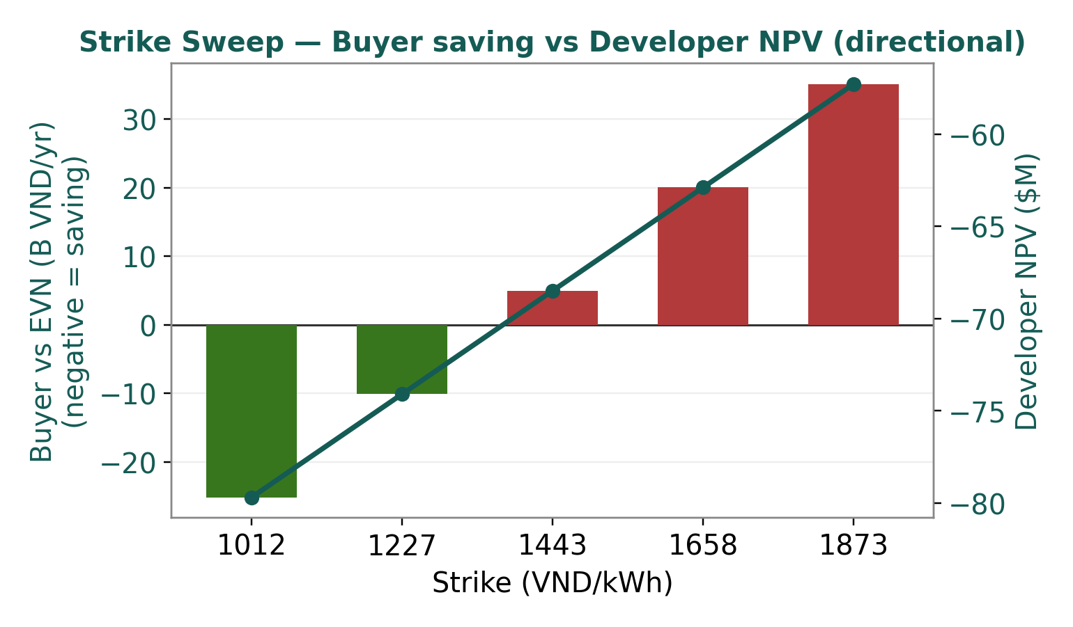
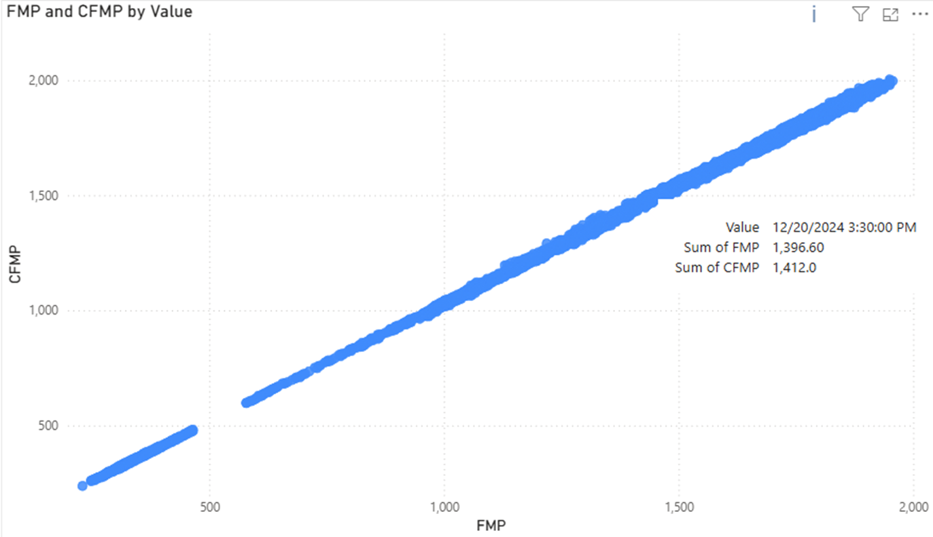
Strike Sweep: Buyer Saving vs Developer NPV
At the 1,012 VND/kWh ceiling strike the buyer saves ~25 B VND/yr ($0.95M); the developer is sub-economic across the band — no overlap. Directional.
AT A GLANCE
Buyer eff. cost
1,552 VND/kWh
EVN avoided
1,913 VND/kWh
Developer NPV
−$80M → −$57M
Overlap
none

Slide 9
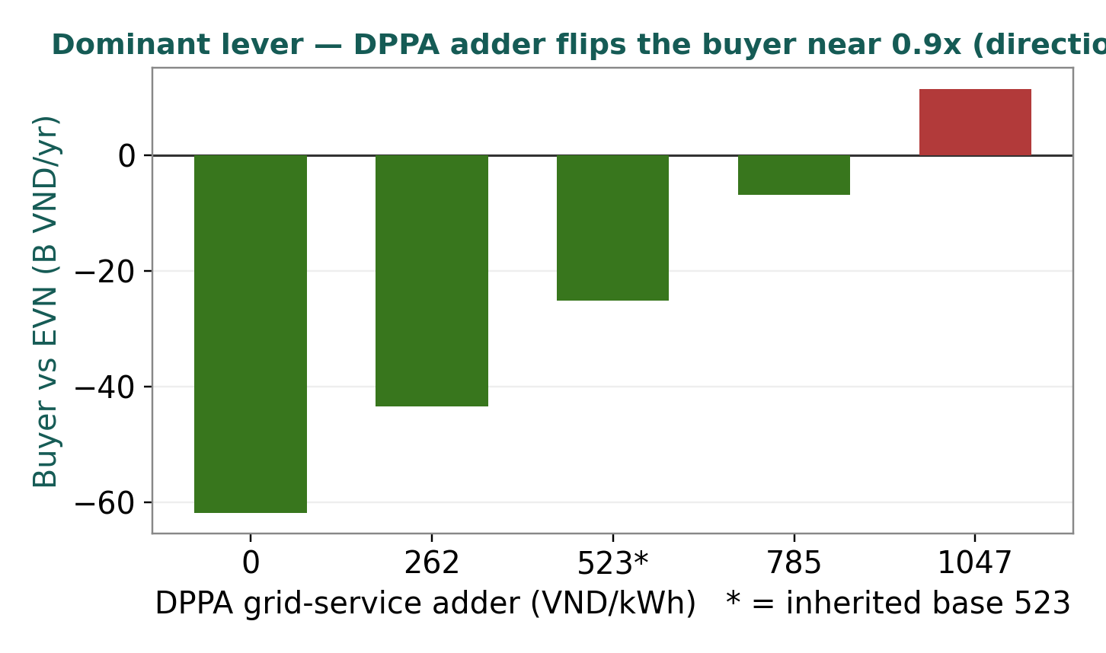
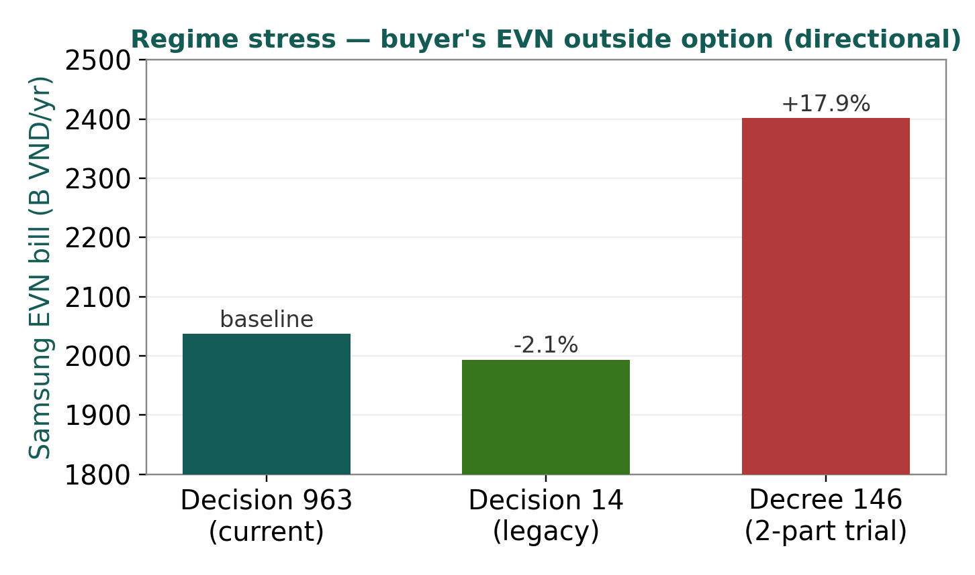
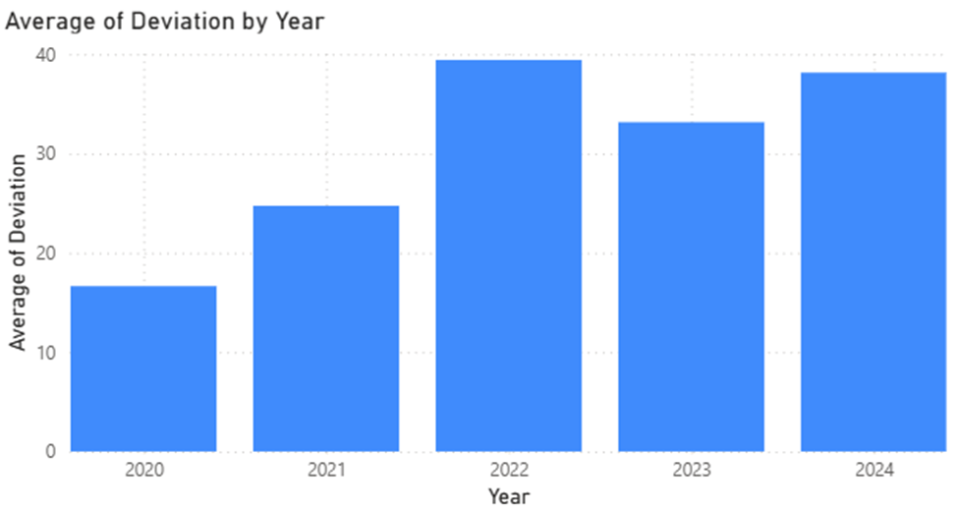
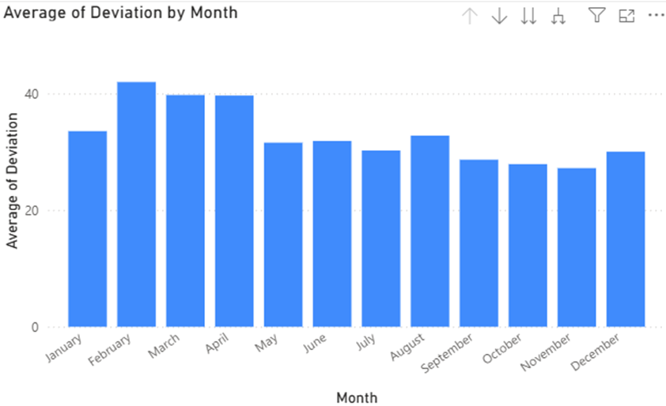
Sensitivities: DPPA Adder & Tariff Regime
Two levers move the buyer result: the inherited DPPA grid-service adder (the dominant lever, break-even ~0.9×) and the tariff regime — the Decree 146 two-part tariff (actual bills from Jul 2026) lifts Samsung's EVN bill ~18%. Directional.

Slide 10
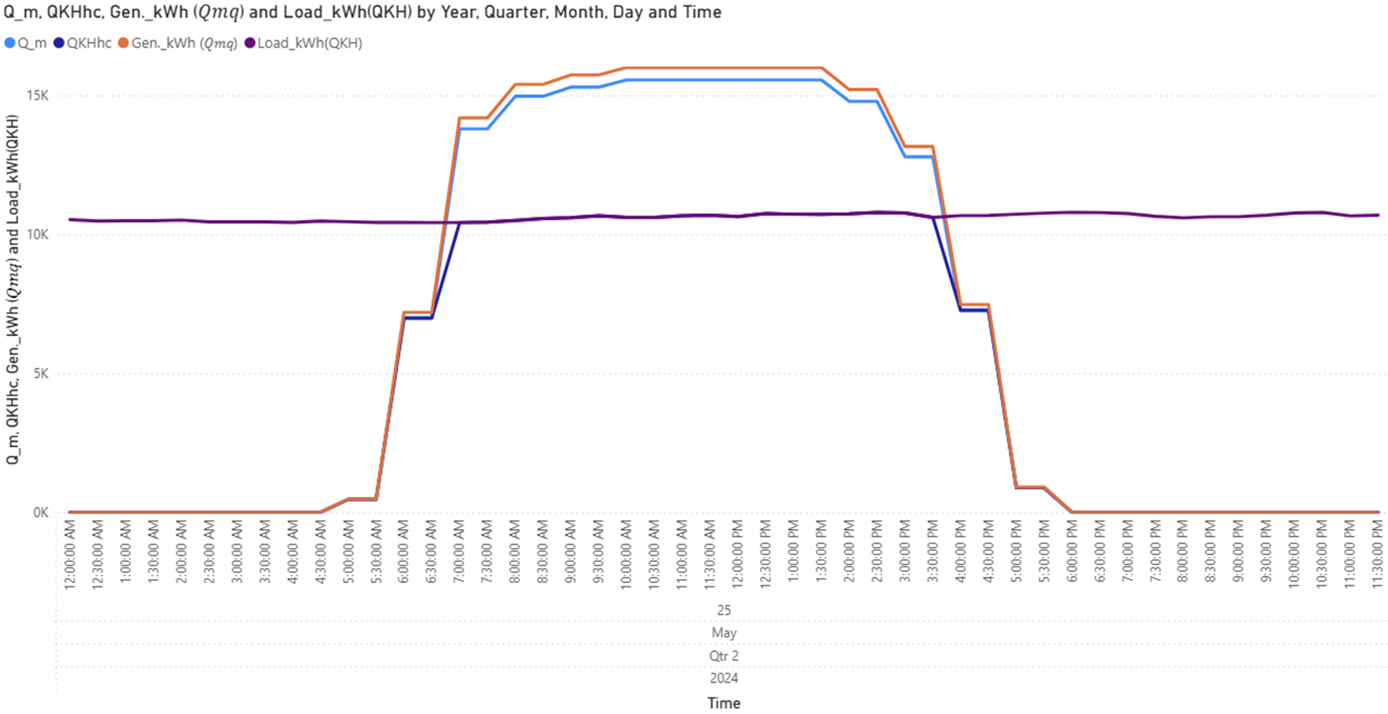
Diurnal Profile
Accurate allocation of QKHhc is critical for determining DPPA cost settlement

Slide 11
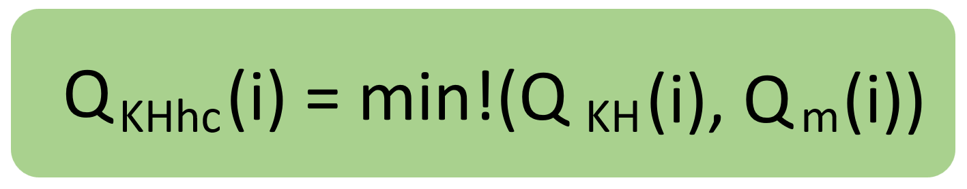
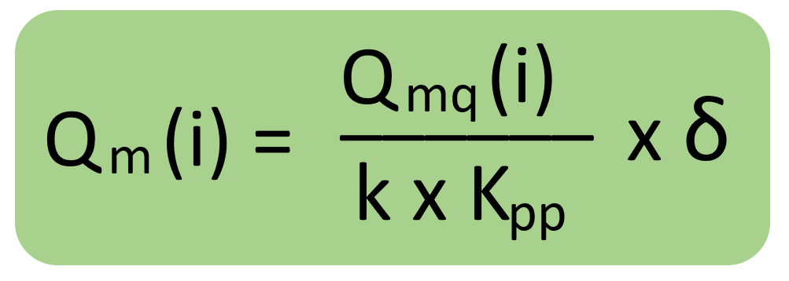
QKHhc is the key factor in all DPPA cost calculations: Buyers must calculate it accurately.
1.General Formula
In which:
Q_KH (i), is the actual electricity output consumed by the Customer (kWh).
Q_m (i) is the actual output generated by the Renewable Energy Generation Unit, converted to the Customer's delivery point (kWh).
2.How to Calculate Q_m (i)
In which:
Q_mq (i) is the metered electricity output (at the Renewable Energy Plant's station) during cycle i (kWh).
k is the loss conversion factor during cycle i (calculated according to competitive electricity market regulations).
K_pp ​ is the annual distribution grid loss conversion factor (as announced by EVN).
δ is the percentage (%) of renewable energy output allocated to the Customer during cycle i (as agreed in the contract).

Slide 12

Payment Mechanism under the CFD
Strike price determines financial settlement through CFD, convert market price volatility into predictable financial flows
How to Calculate The total revenue (or clearing cost) under the CFD contract in a payment cycle is calculated by:
In which:
𝑅𝐶 – Revenue under the CFD contract in the payment cycle (VND)
𝑖– The i-th trading cycle in the payment cycle
𝐼– The total number of trading cycles in the payment cycle
𝑃_𝑐 (𝑖) – The committed price in the forward contract (strike price) at cycle i (VND/kWh)
𝐹𝑀𝑃(𝑖)– The reference price (spot market price) at cycle i (VND/kWh)
𝑄_𝑐𝑎 (𝑖)– The committed quantity in the forward contract at cycle i (kWh)

Slide 13
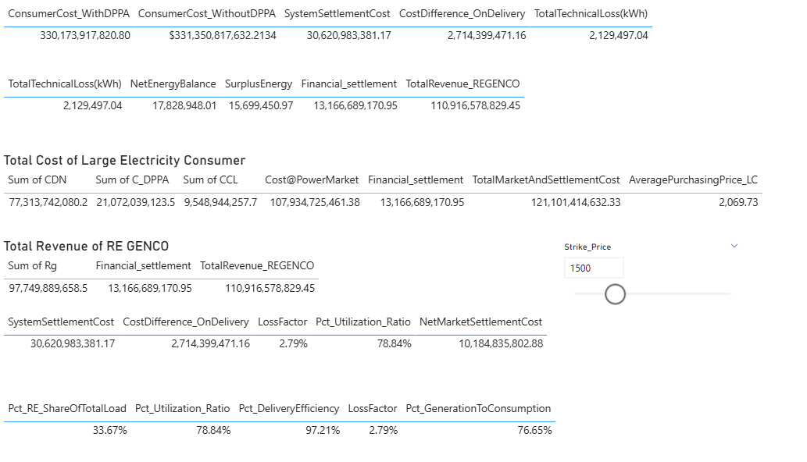
Quantify DPPA Costs to Assess Feasibility & Negotiate RE Supply
Feasibility analysis enables buyers to compare DPPA against traditional procurement with confidence

Slide 14
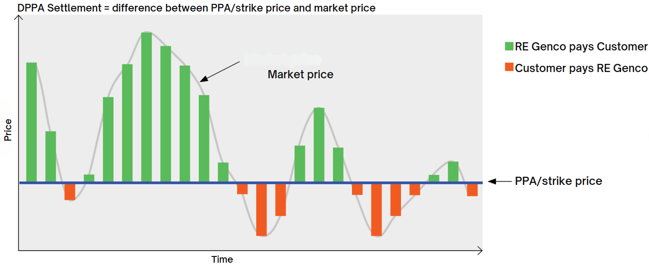
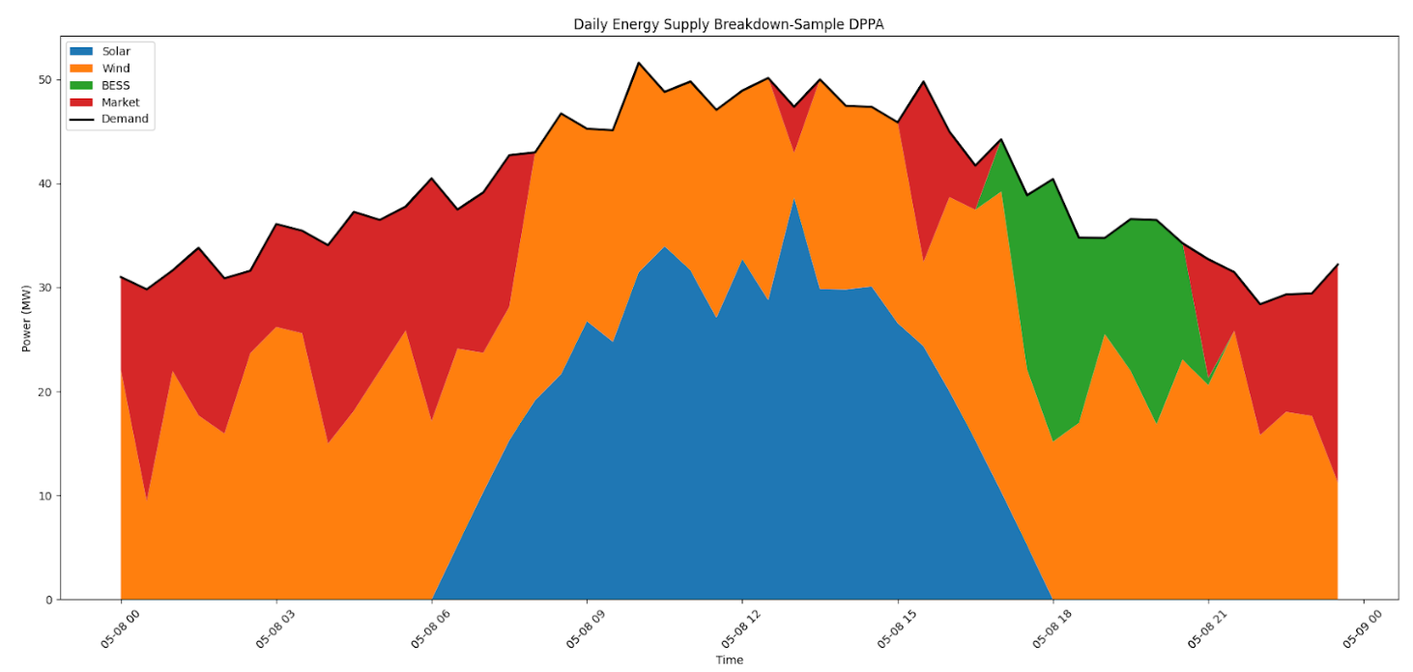
Samsung × TTC: Worked Case (directional)
THE DEAL
Buyer: Samsung SEVT (Thai Nguyen)
Generator: TTC Duc Hue 2, Tay Ninh
49 MWp / 41.4 MWac · ~70 GWh/yr
Financial CfD, Decree 57/2025 · live 1 Jun 2026
DIRECTIONAL RESULT
Buyer saves ~25 B VND/yr ($0.95M) at the 1,012 strike
Buyer flips to premium above ~1,440 VND/kWh
Developer sub-economic across band (no overlap)
Adder is the dominant lever (break-even ~0.9×)
Scenario DPPA Negotiation
Recommended: buyer-favourable, developer sub-economic — directional, not bankable.

Slide 15
Recommendation & Path to Bankable (directional)
Position: buyer-favourable, developer sub-economic — no clean overlap. Directional, not bankable.
For the offtaker (Samsung): the DPPA structurally beats EVN at the regulated ceiling strike (~$0.95M/yr saving on the 70 GWh slice); it strengthens as the Decree 146 two-part tariff hits actual bills from Jul 2026 (Phase 3).
For the generator (TTC): do not read 'uneconomic' from this screen — it is conservative (revenue on the contracted 70 GWh, not the plant's full ~92.5 GWh yield; $750/kW capex). Counting full output + a merchant tail would lift NPV.
Three inputs move this from directional to bankable:
1. the real DPPA grid / wheeling fee (the dominant lever)
2. a Tay Ninh site-specific CFMP / FMP series
3. the actual negotiated strike and tenor

